Slide 1
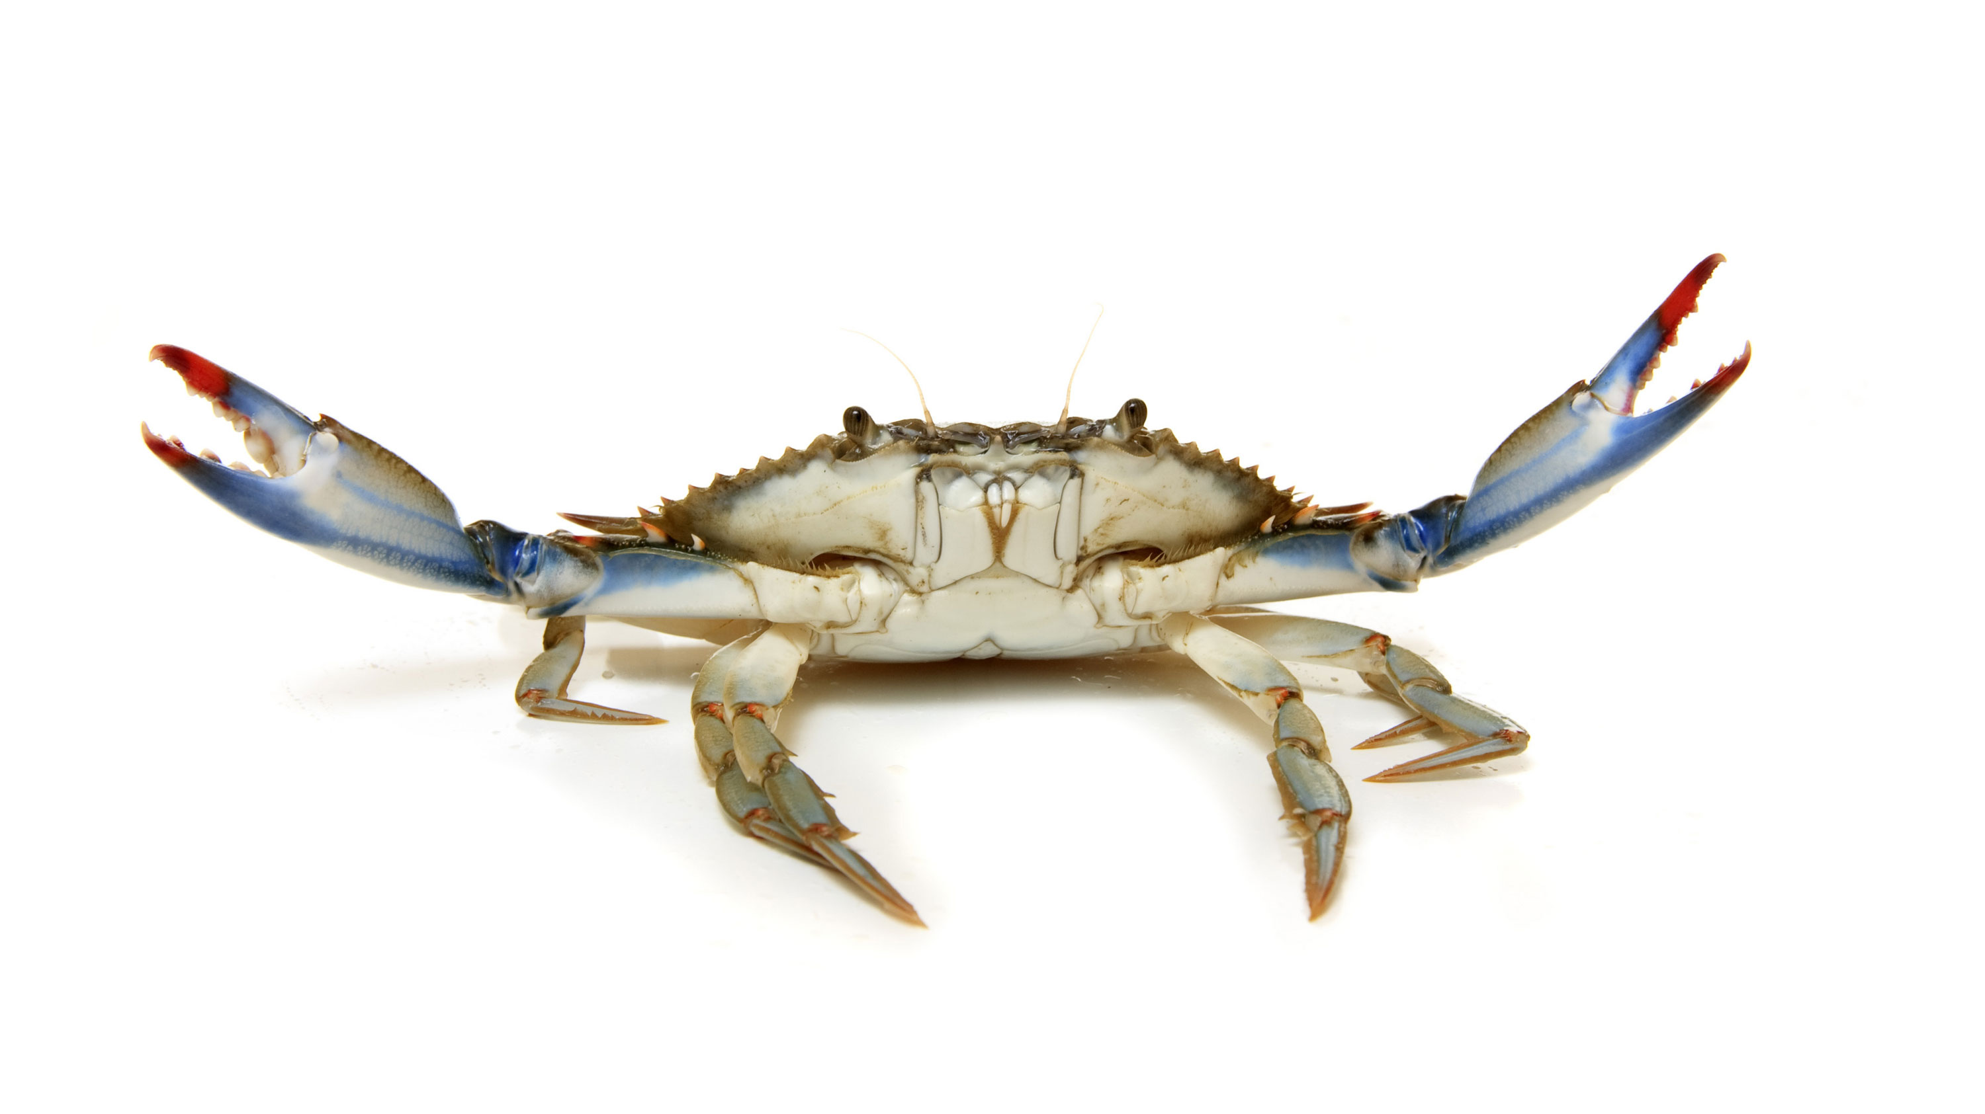
The Effect of TEA, 4-AP and in Combination on Primary Sensory Neurons in a Crustacean Model

Slide 2
Introductions
My name is Hannah Tanner.
From Kentucky.
Student at Eastern Kentucky University.
Major in Biomedical Sciences (concentration: Pre-Medicine)
Major in Psychology (concentration: Brain and Cognitive Sciences)
Minor in Chemistry
Home Health Care.
Research in Dr. Coopers lab summer 2021.

Slide 3
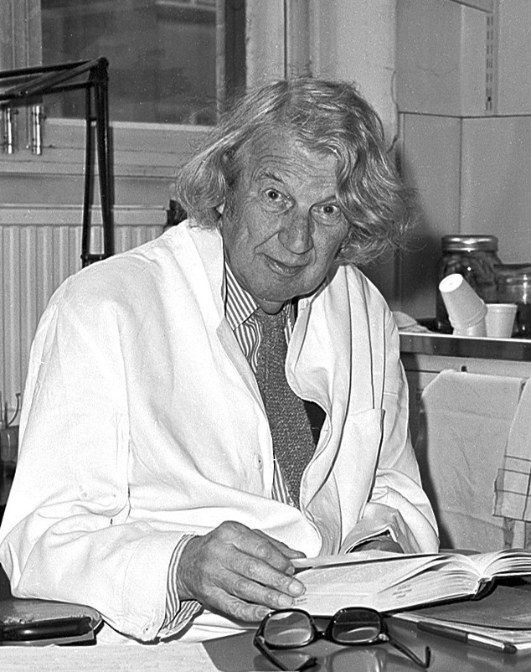
John Zachary Young
Notes:
1930’s by English zoologist john Zachary young

Slide 4
https://pubmed.ncbi.nlm.nih.gov/2417975/
https://www.karger.com/Article/Abstract/72160
Notes:
The squid axon was big, easily accessible, and it was unmyelinated,

Slide 7
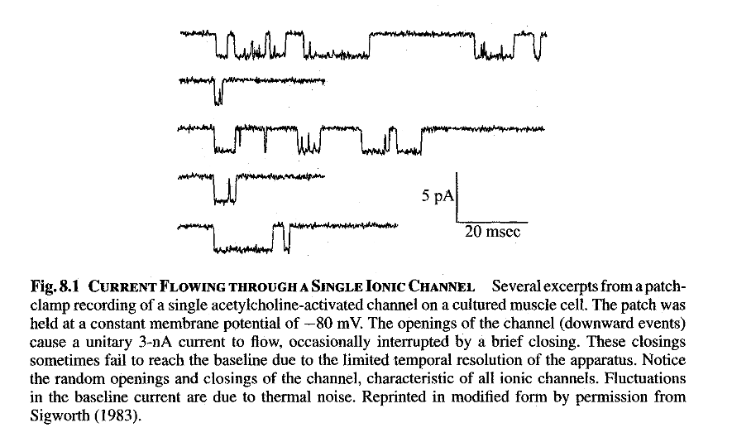

Slide 8
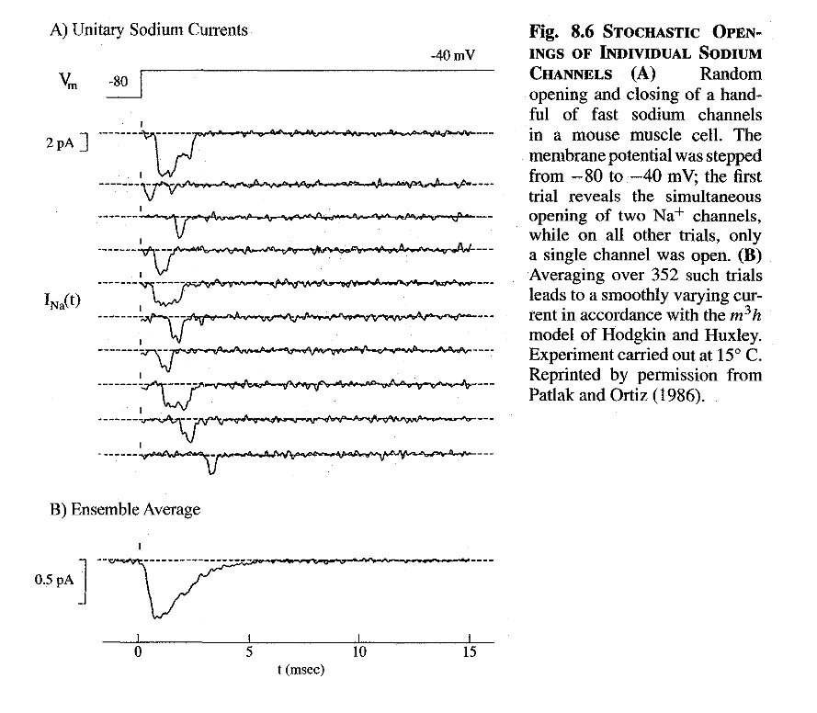

Slide 9
Nernst equation :
$$V=\frac{RT}{zF} ∙ln\frac{⁡{[X]}_{out}}{{[X]}_{in}}$$
E_{Na} or E_{K}
Goldman-Hodgkin-Katz (G-H-K) equation:
Here is a generalized G-H-K equation for Na⁺, K⁺, and Cl⁻ ions:
$${Em}_{K, Na, Cl}=\frac{RT}{F}ln \frac{P_{{Na}^{+}}{\left[{Na}^{+}\right]}_{out}+P_{K^{+}}{\left[K^{+}\right]}_{out}+PCl[Cl]in}{P_{{Na}^{+}}{\left[{Na}^{+}\right]}_{in}+P_{K^{+}}{\left[K^{+}\right]}_{in}+PCl[Cl]out}$$
Notes:
Nernst: concentration gradient difference induces a voltage difference.

Slide 10
Now, your project…

Slide 11
tetraethylammonium chloride (TEA)
Notes:
Produced by alkylation of triethylamine with ethyl chloride. Testing for its ability to block K+ channels.

Slide 12
Akanda N, Molnar P, Stancescu M, Hickman JJ. Analysis of toxin-induced changes in action potential shape for drug development. J Biomol Screen. 2009 Dec;14(10):1228-35. doi: 10.1177/1087057109348378. PMID: 19801532; PMCID: PMC3829631.

Slide 13
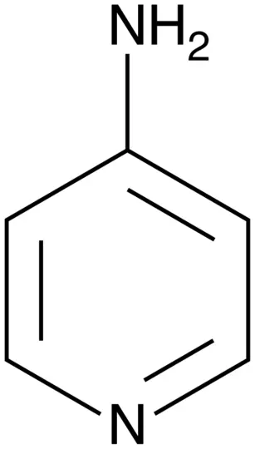
4-aminopyridine (4-AP)
Notes:
Organic compound that was undergoing phase III clinical trials in 2008. It was approved by the FDA in January 2010 and has been used to treat some symptoms of Multiple Sclerosis. MS is when the immune system causes the myelin in nerve cells to break down. 4-AP has been shown to treat some symptoms.

Slide 14
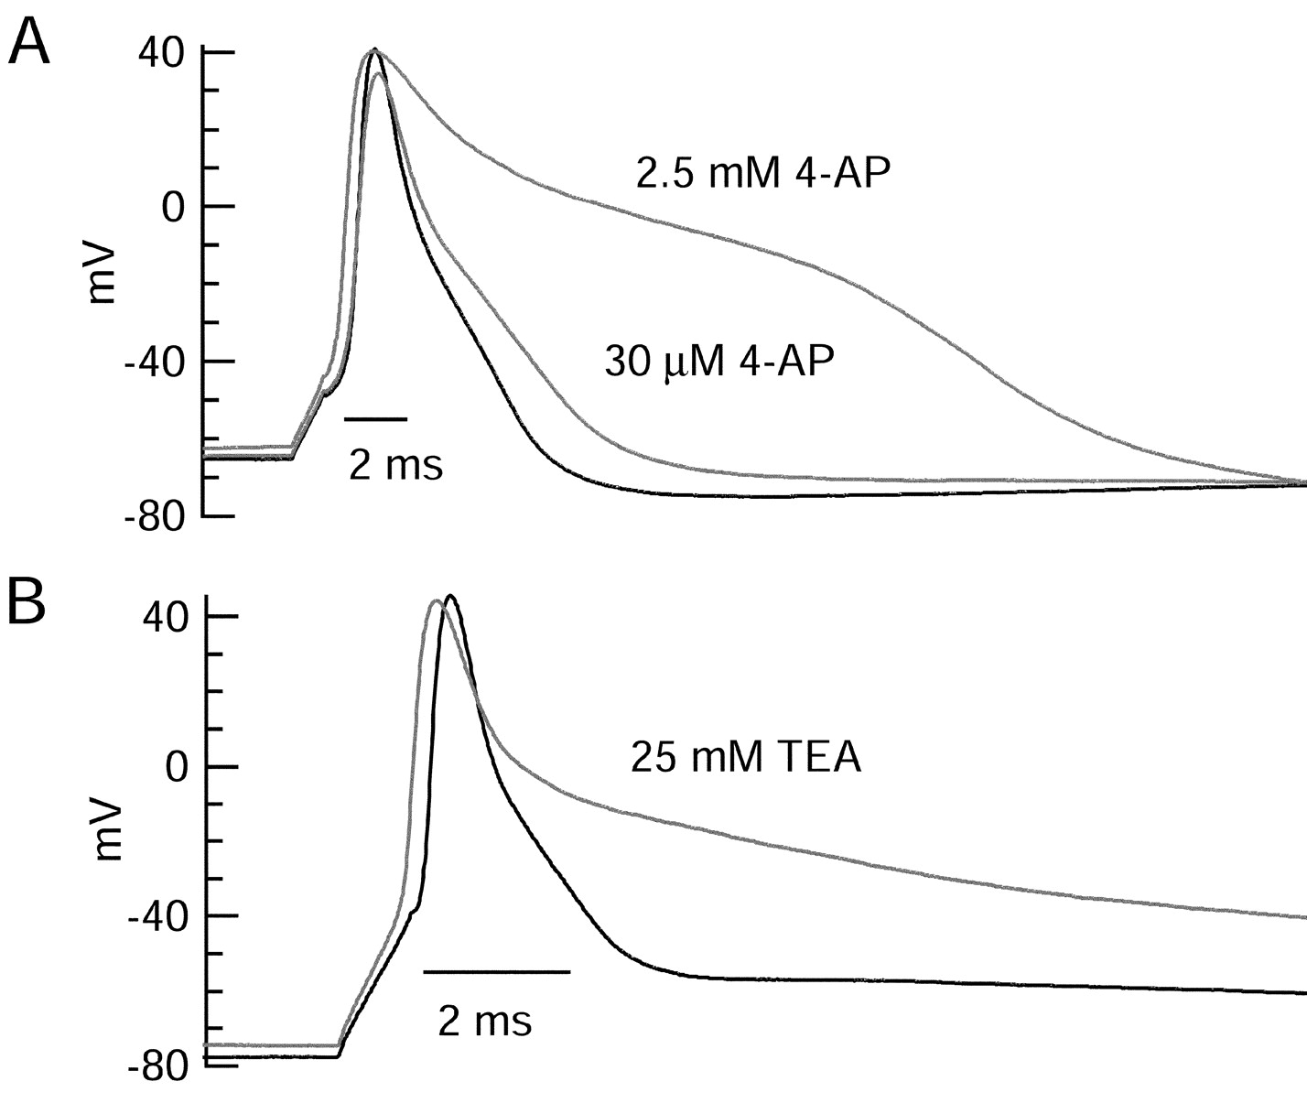
The overall voltage-dependent potassium current in the neurons could be split into three major components based on pharmacology and kinetics during step voltage pulses: I_{D} (fast activating, slowly inactivating, and sensitive to 4-aminopyridine at 30 μm),I_{A} (fast activating, fast inactivating, and sensitive to 4-aminopyridine at 3 mm), andI_{K} (slowly activating, noninactivating, and sensitive to external TEA at 3–25 mm). The potassium current during the action potential was composed of approximately equal contributions of I_{D} andI_{A}, with a negligible contribution ofI_{K}.
https://www.jneurosci.org/content/22/23/10106
Notes:
Fast acting vs slow acting K+ channels. Rodent hippocampus neurons

Slide 15
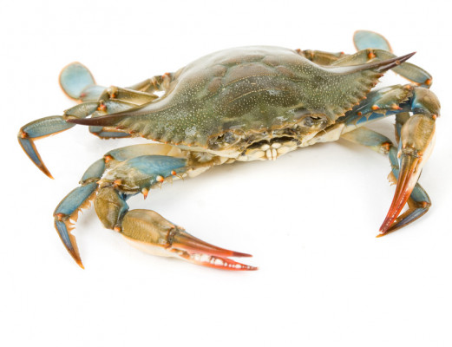
Model Organism: Blue Crab

Slide 16
Notes:
Dissected, suction electrode placed in it.

Slide 17
Control Group: Saline
A: Saline
solution changed
exercised 20x
B: Saline
solution changed
exercised 20x
C: Saline
2 sec

Slide 18
100mM 4-AP
A: Saline
solution changed to 100mM 4-AP
waited 10 minutes
exercised 20x
B: 100mM 4-AP
solution changed to saline washout
waited 10 minutes
exercised 20x
C: Saline wash
2 sec

Slide 19
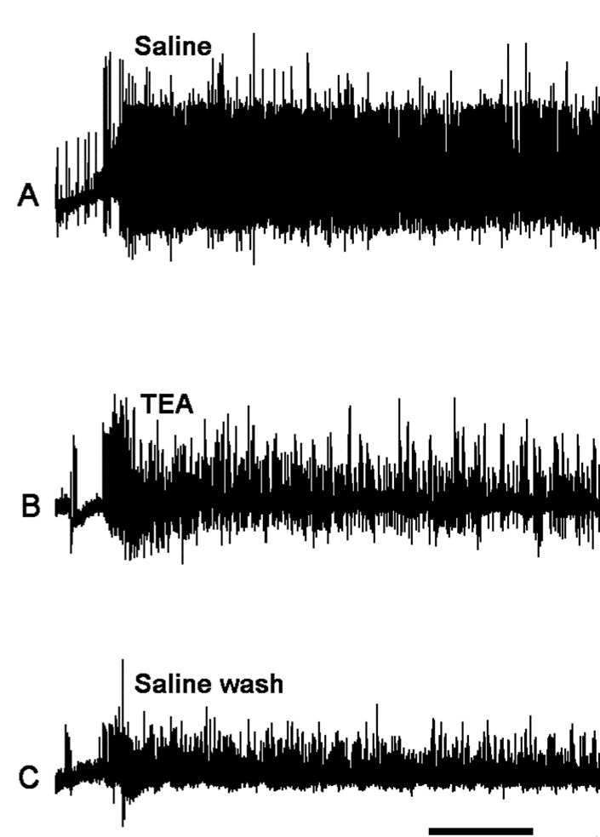
50mM TEA
A: Saline
solution changed to 50mM TEA
waited 20 minutes
exercised 20x
B: 50mM TEA
solution changed to saline washout
waited 20 minutes
exercised 20x
C: Saline wash
2 sec

Slide 20
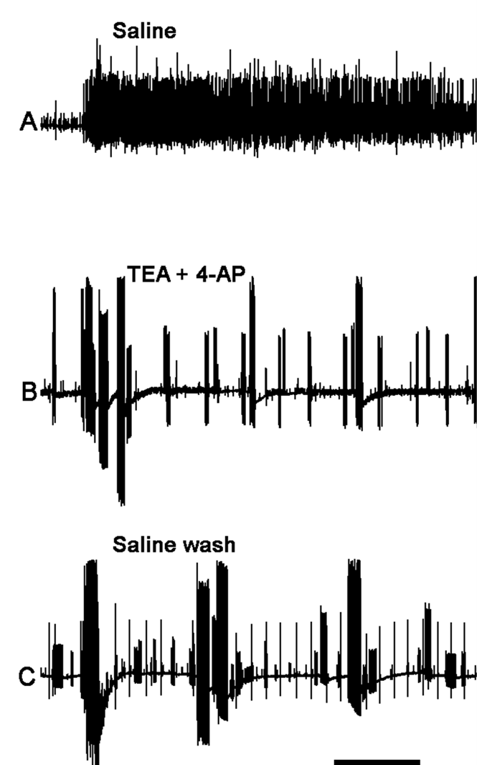
50mM TEA and 100mM 4-AP
A: Saline
solution changed to 50mM TEA and 100mM 4-AP
waited 20 minutes
exercised 20x
B: 50mM TEA and 100mM 4-AP
solution changed to saline washout
waited 20 minutes
exercised 20x
C: Saline wash
2 sec

Slide 21
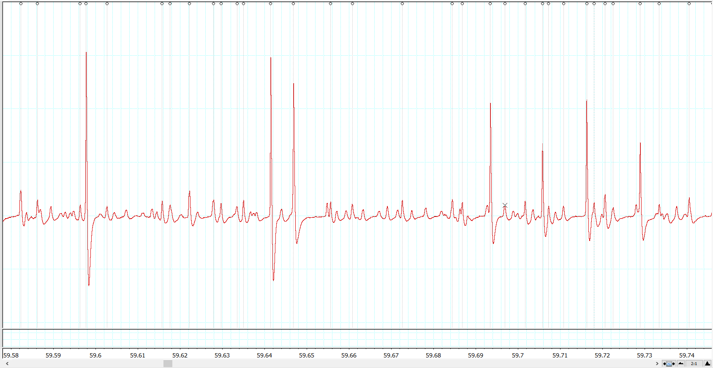
Counting

Slide 22
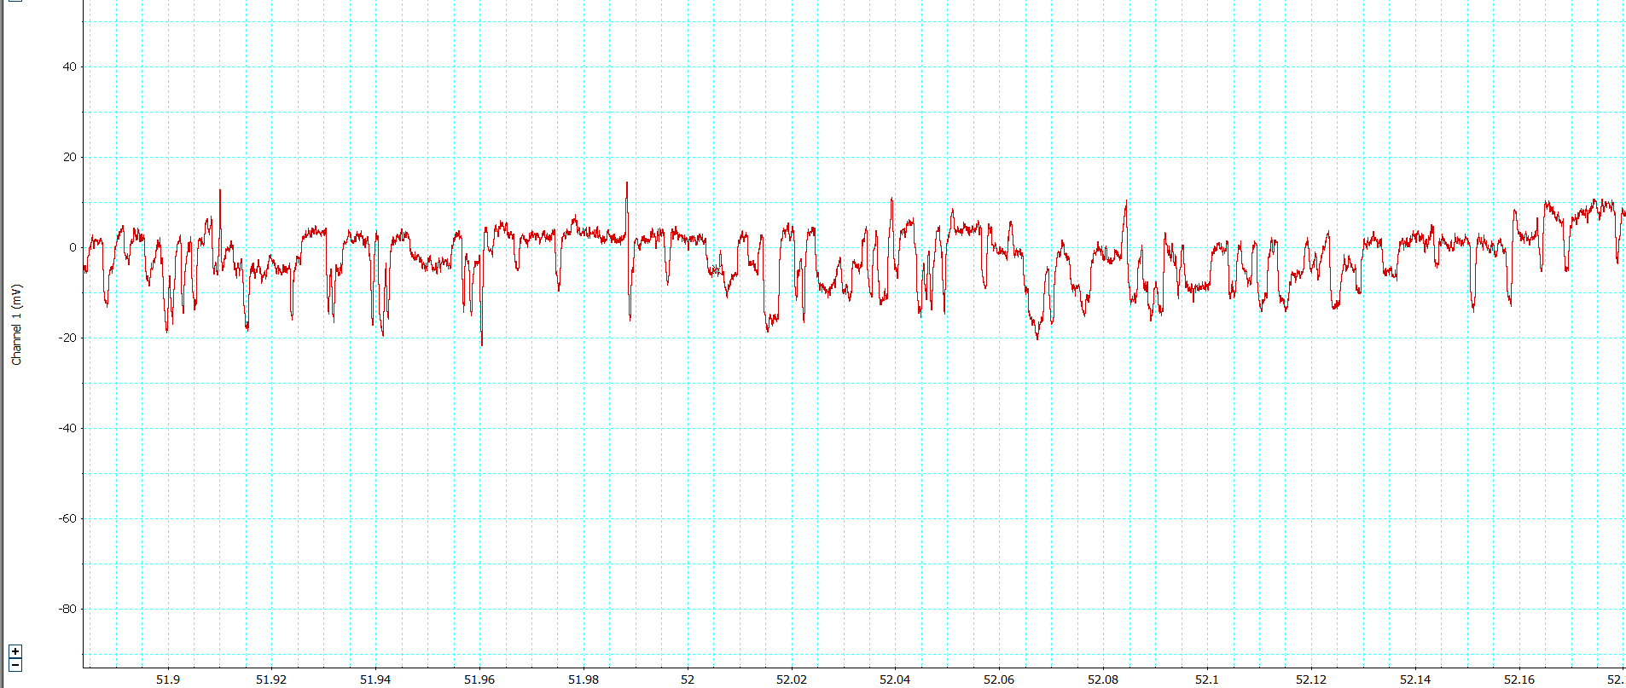
????

Slide 23
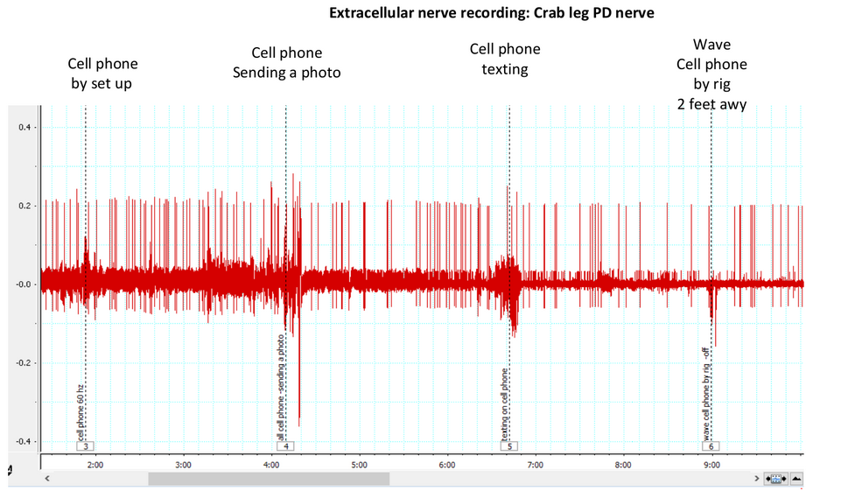

Slide 24
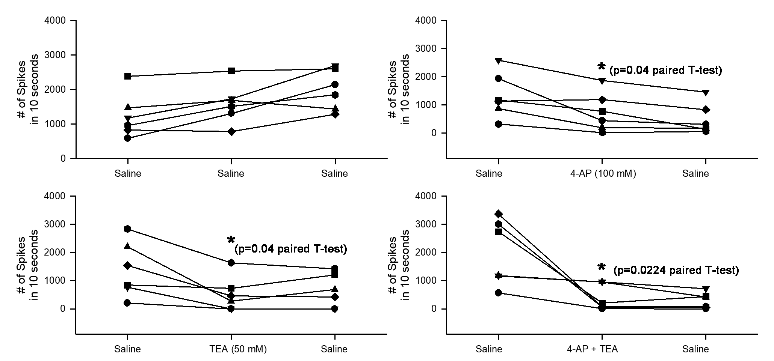
Number of spikes in each preparation within a 10 second interval

Slide 25
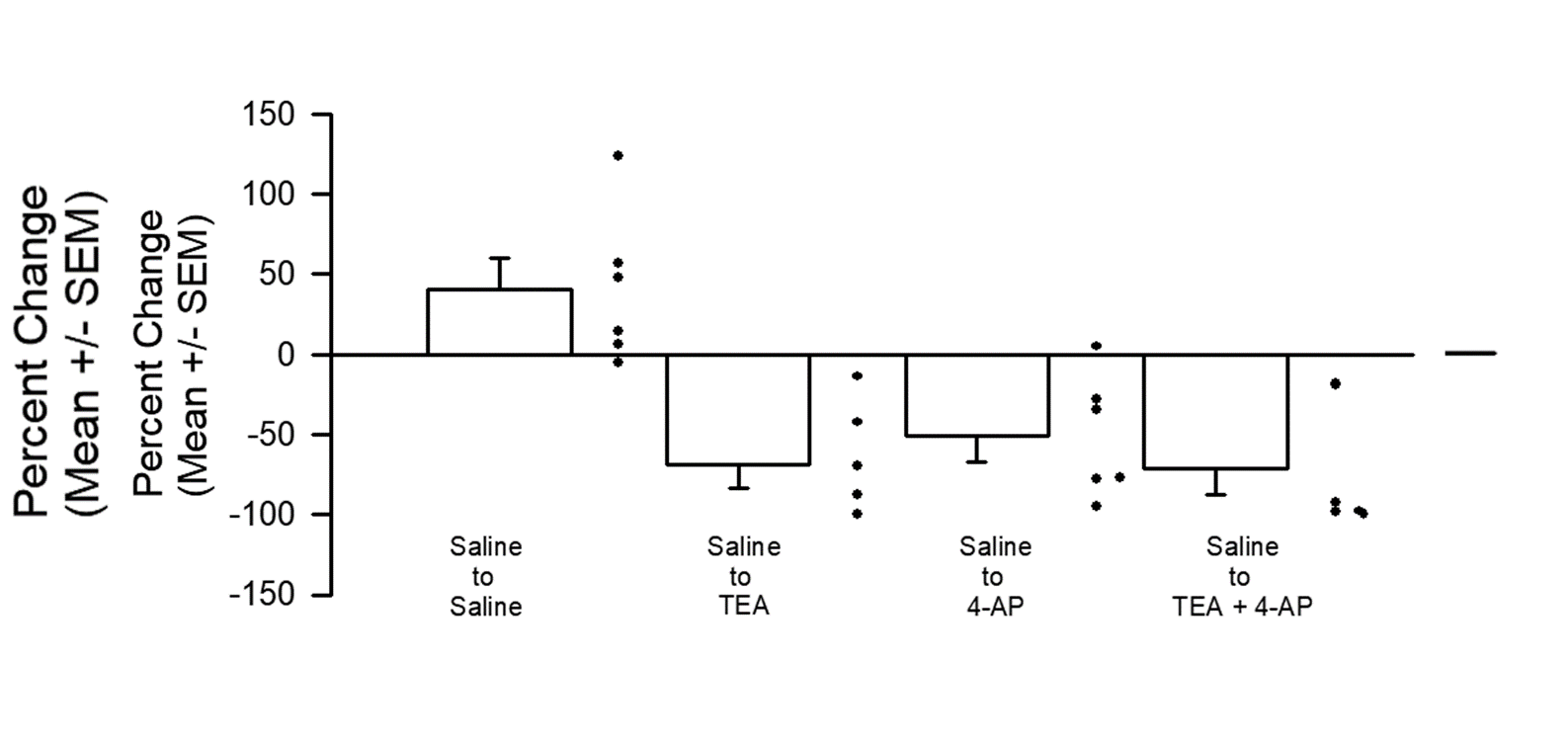
Percent change in the number of spikes counted after the drug was added

Slide 26
Percent Decrease
Compound | Decreased By
100mM 4-AP | 51.15%
4-AP washout | 66.91%
50mM TEA | 78.88%
TEA washout | 57.95%
50mM TEA + 100mM 4-AP | 70.55%
TEA + 4-AP washout | 80.48%

Slide 27
Conclusion
1. 4-AP at 100mM concentration depressed the activity of the primary sensory neurons.
2. Likewise, TEA at 50mM concentration also depressed sensory nerve activity.
3. When 4-AP and TEA were combined, the activity was depressed at a less than additive effect of the two compounds effect combined.

Slide 28
Reproducibility
You’ll be given an unknown solution (Saline/4-AP/TEA/or combination).
Analysis performed to see trends.
After analysis, you’ll see which solution you have and if the results match.
You will also be given pre-determined data to analyze for reproducibility.

Slide 29
Contact Info
Dr. Robin Cooper
RLCOOP1@email.uky.edu
Hannah Tanner
hannah_tanner1@mymail.eku.edu

